Slide 1
Computer Stuff
CDT & Biscuits

Slide 2
CDT CLUSTER

Slide 3
Not really a cluster
“A computer cluster consists of a set of loosely or tightly connected computers that work together so that, in many respects, they can be viewed as a single system”
Should expose itself as one computer
Send a job to it and it sorts itself out
We have a collection of computers.

Slide 4
Architecture

Slide 5
Choosing a node
Trial & Error – who’s on what
Booked (wiki) – who should be?
To connect, from within DICE simply:
ssh node (node can be james01, charles01 etc.)
From outside – connect to ssh sXXXXXXX@student.inf.ed.ac.uk
Then ssh node

Slide 6
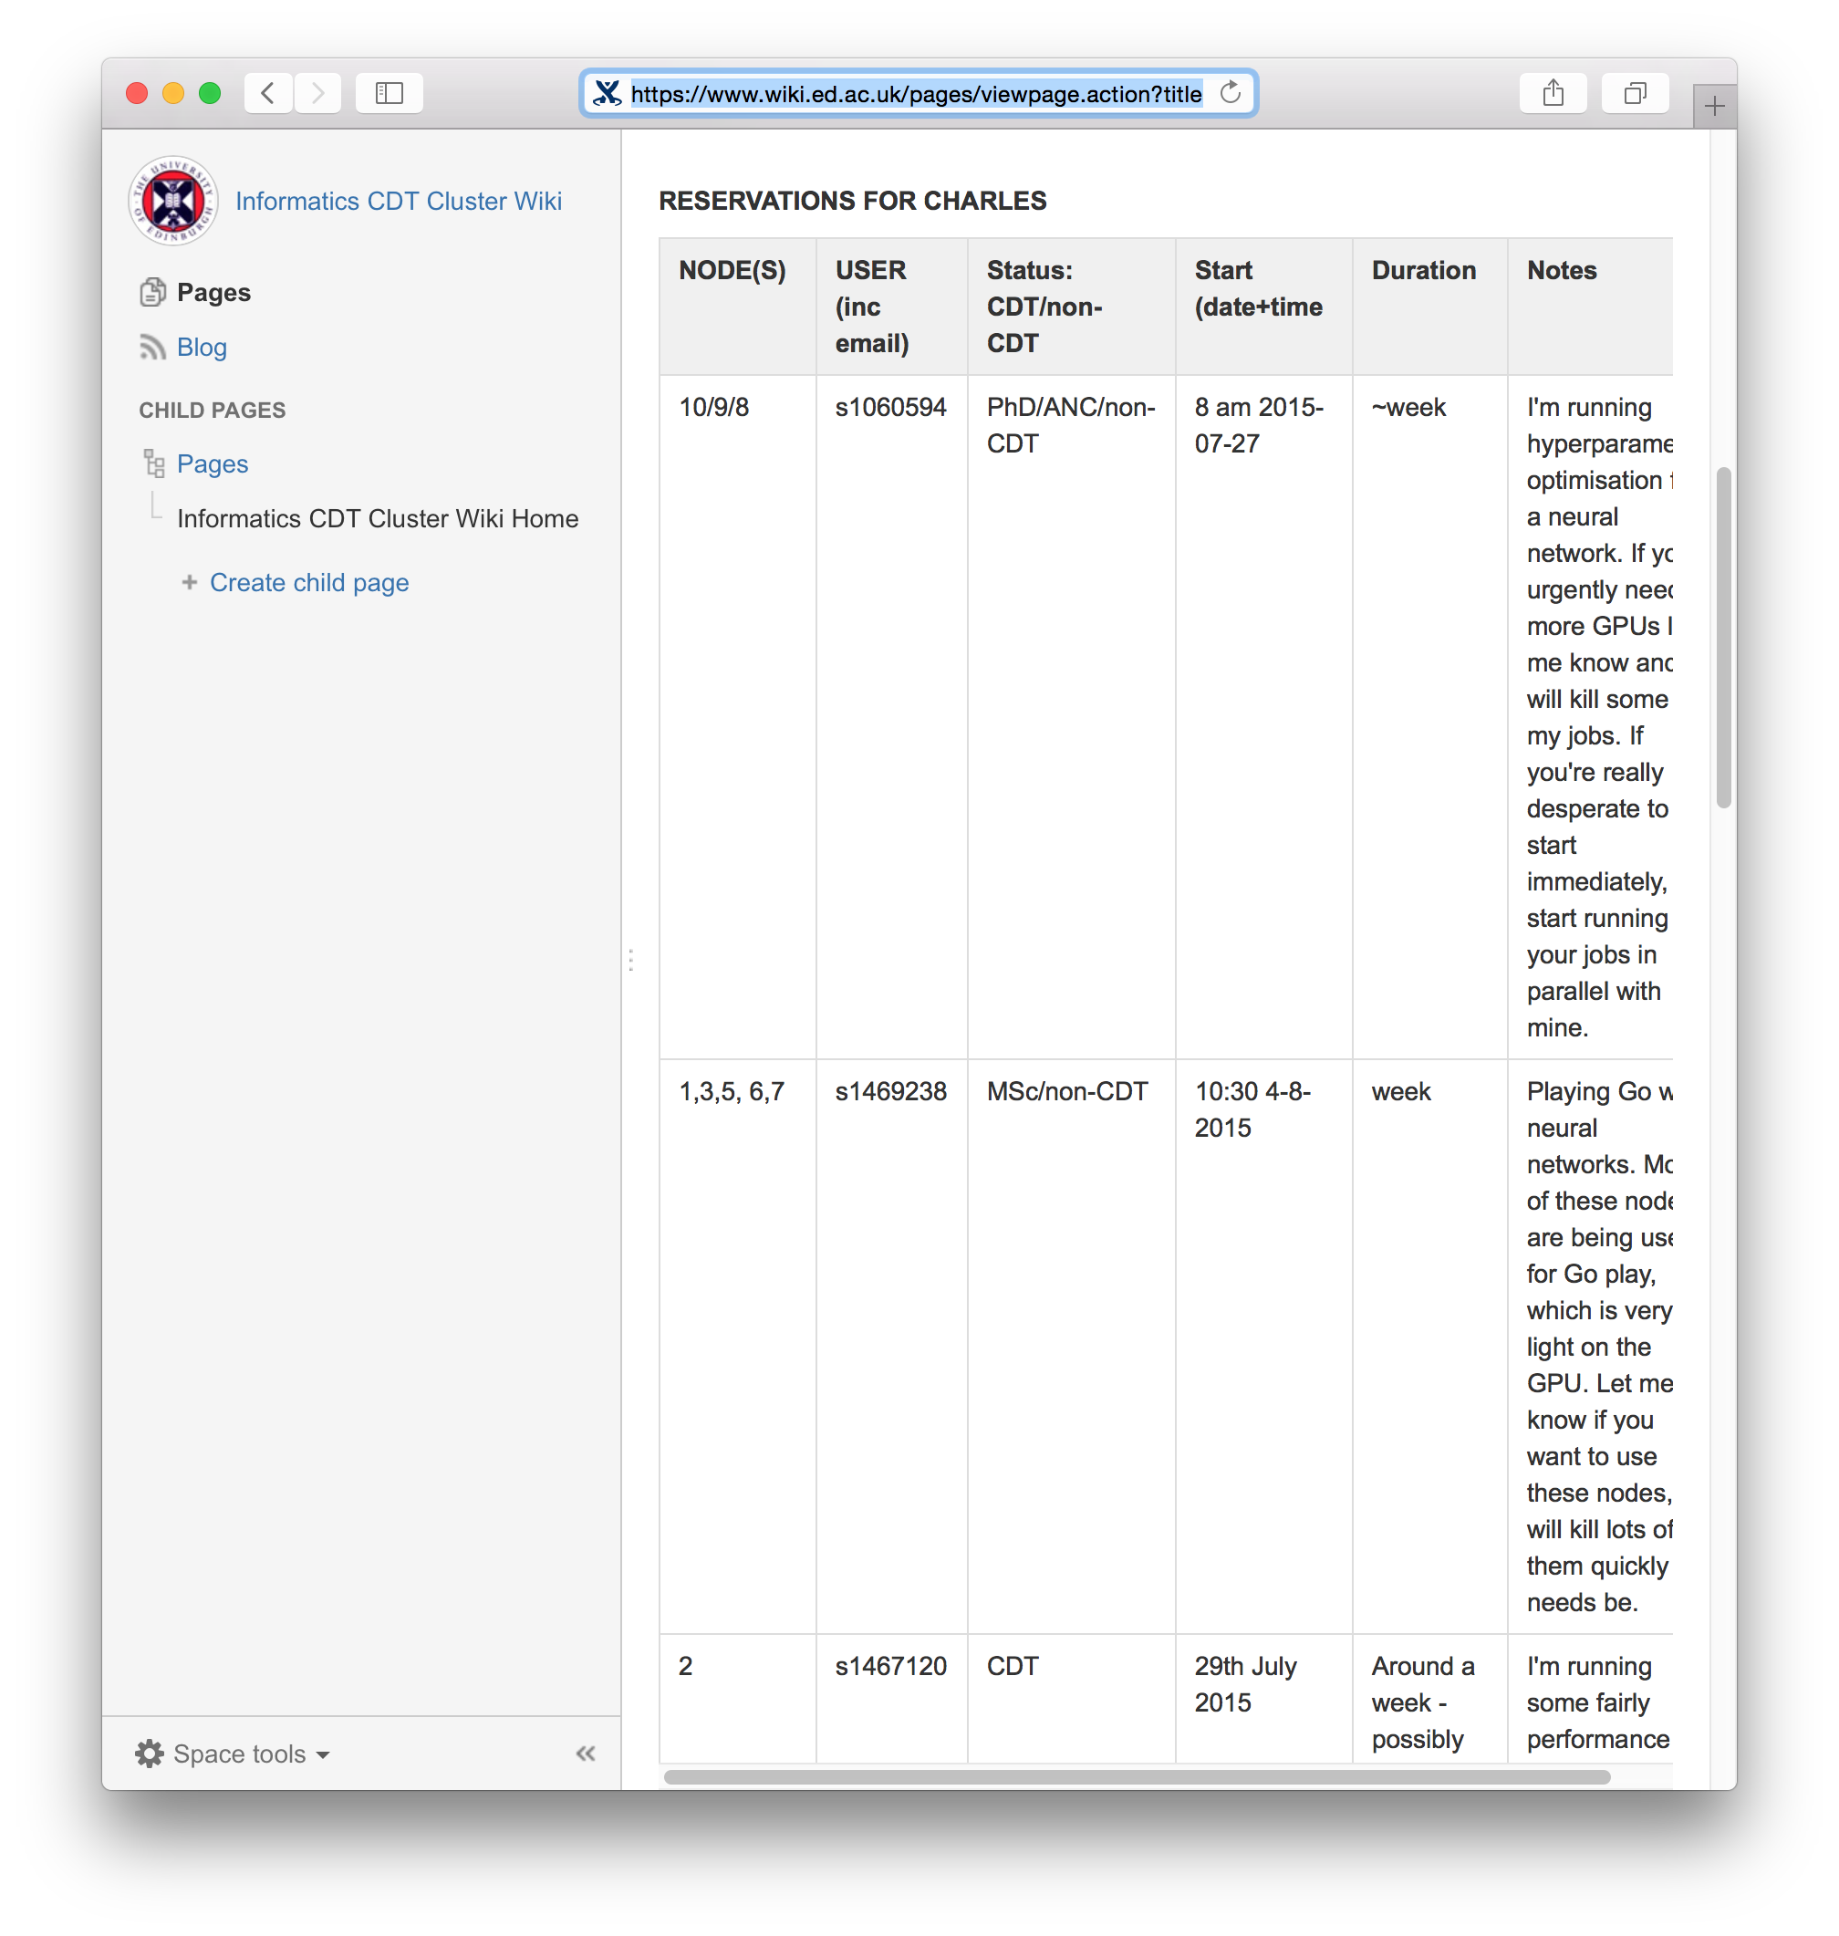
Process
Consult the Wiki:
https://www.wiki.ed.ac.uk/display/ICCW/Informatics+CDT+Cluster+Wiki+Home

Slide 7
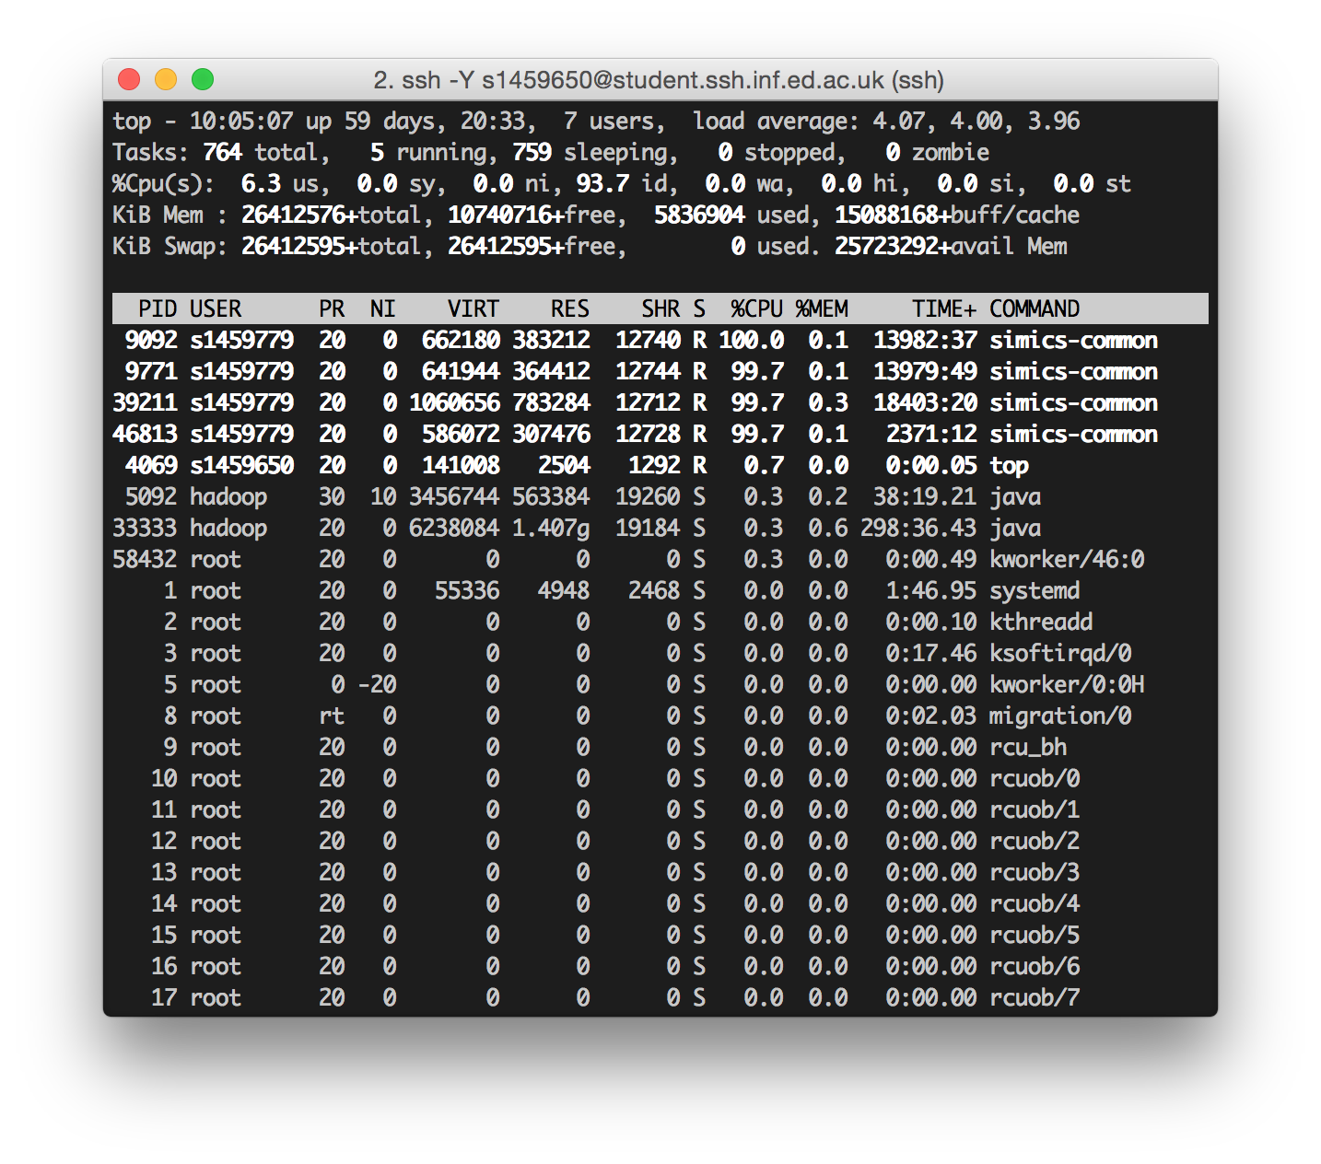
Checking a `big-data’ node
Some manual checking:
top
Which users are using how many cores
How much memory used
Not super intuitive
who
Who is connected
How many connections

Slide 8
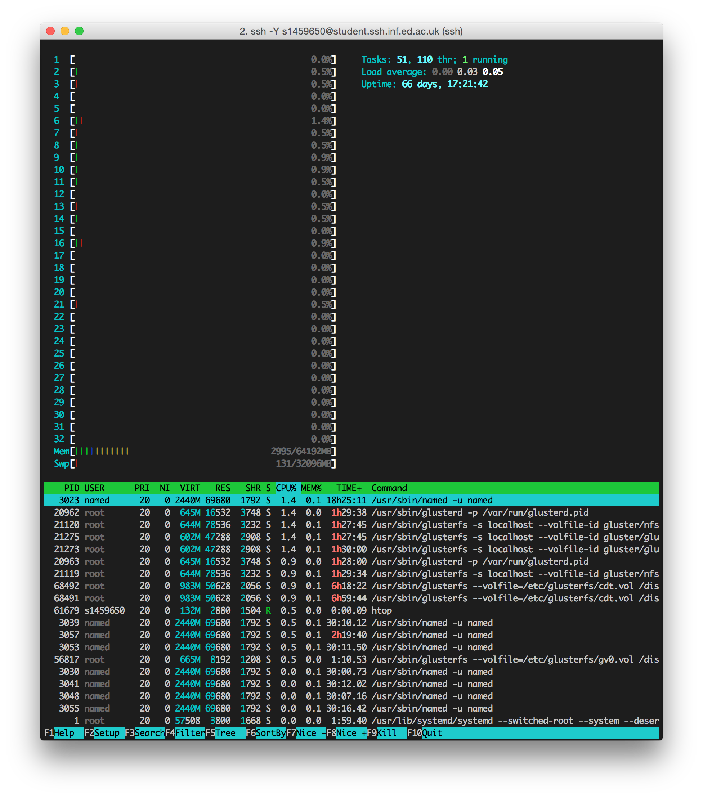
htop
This is recommended for checking servers.
jamesXX is problematics. 64 cores.
You can compile in userspace
More sorting options

Slide 9
Checking a GPU node
Bunch of nvidia utilities
Script available on the wiki page, save to nvidia.sh
Run sh nvidia.sh
Gives list of processes
GPU-ey people like Harri may know more

Slide 10
Kerberos & session timeouts
Scenario:
You’ve opened an ssh tunnel to a noe
Your job is running (whether using screen or not)
It takes 20 hours to converge / finish
It can’t save anything -- `Permission Denied’
Congratulations, your ticket has expired.
DICE/IS policy
Can’t be modified
Roughly 18 hours

Slide 11
Avoiding data-loss
Get a terminal from your current session
MATLAB: !command
Ipython: !command should work
Python / Java etc.: It’s gone – crashed
If you managed to get a terminal in the same session:
DICE command renc
What this is doing, normal Kerberos stuff:
kinit sXXXXXXX@INF.ED.AC.UK
aklog
You now have your permissions back

Slide 12
Better strategy: /disk/scratch
Each node has ~3TB of scratch space
Good: Write access to all:
Have your applications write to here
Even if Kerberos token is lost, data can still be read / written
Much more space than AFS allocation
Bad: Write access to all:
Do not assume everyone is competent in programming
Do not assume even those who are competent don’t have bugs
Assume everything will burn
Plan for armaggeddon
(My plan: REPLICATE REPLICATE REPLICATE)

Slide 13
Replicating on the cluster
Mount remote /disk/scratch/$USER in your folders:
/disk/scratch/$USER/project/james01 – sshfs’d into james01
Super messy
Not for the faint of heart – especially if managing through your app
Just a pointer that replication can be achieved
This is a bandaid whilst awaiting a proper cluster setup

Slide 14
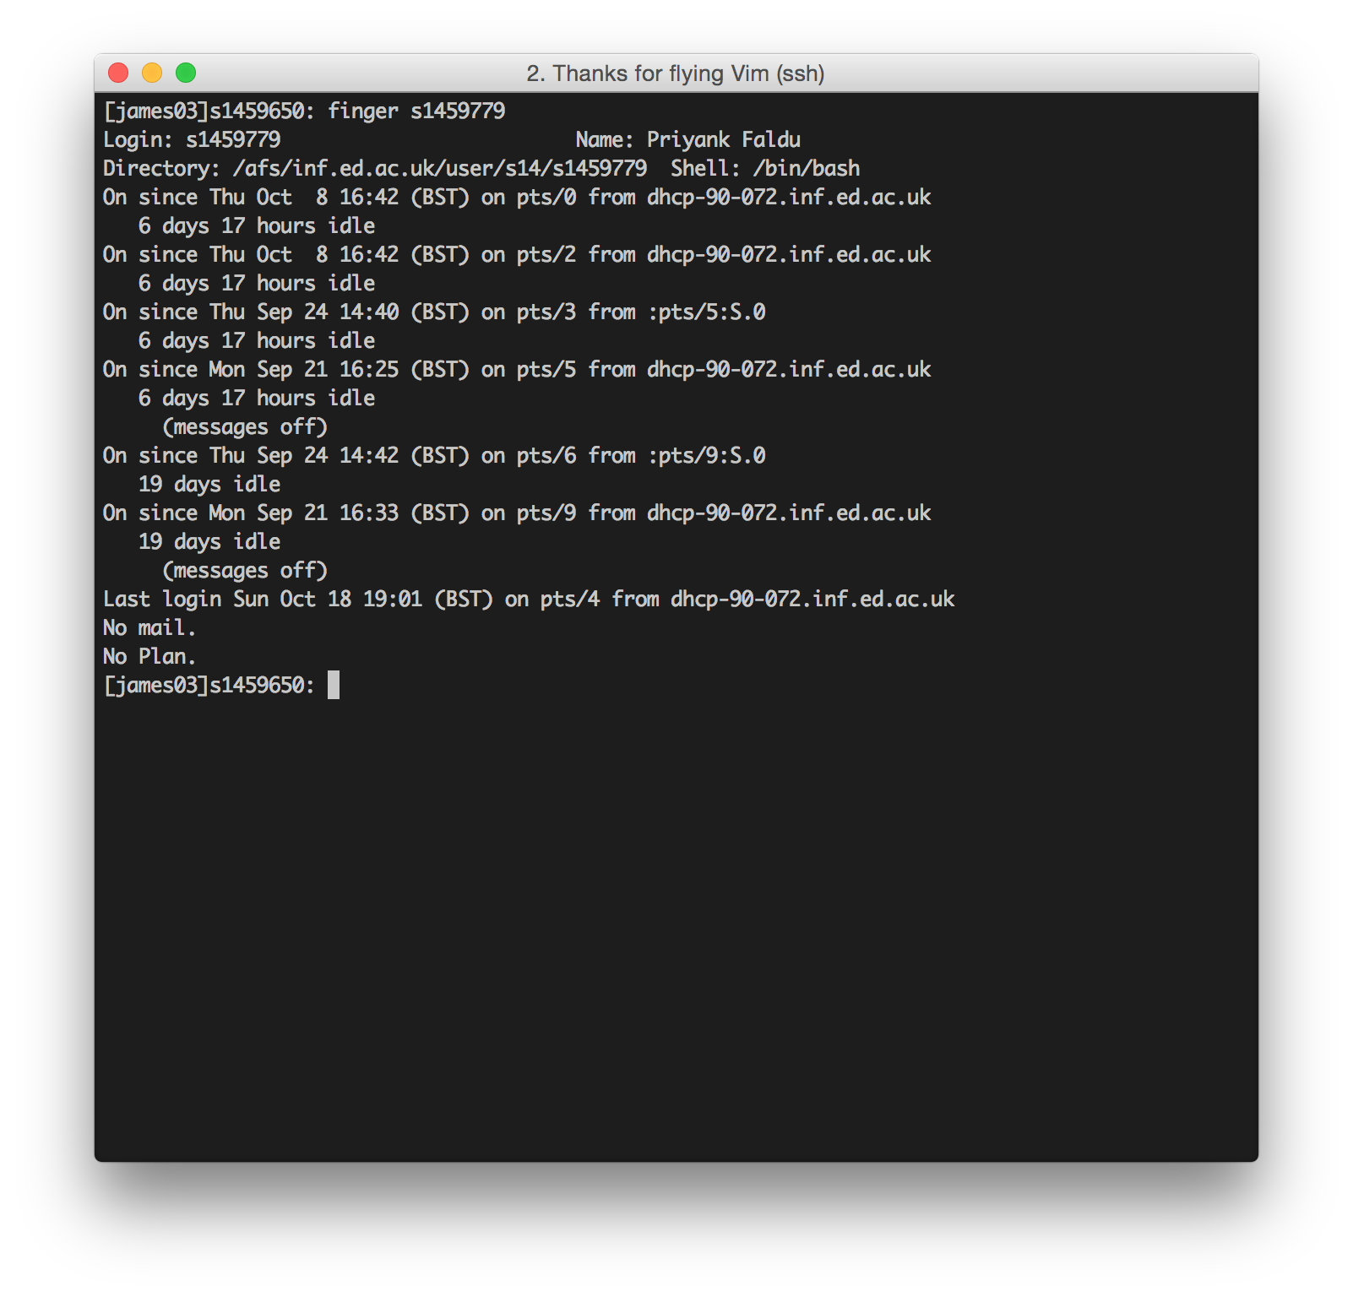
Conflict resolution: someone using your booked node.
Diplomacy. Not violence.
The wiki is gospel.
You can write to the wiki at any time – if it’s not booked and it’s being used, book it.
Researcher eats researcher world.
Email them, or go and see them (far scarier for both)
finger them

Slide 15

Contain rage if non-CDT
(this is allowed)

Slide 16
GNU screen
Launching jobs via an ssh tunnel has issues
If the tunnel breaks, your job is killed
Unless – you’re able to push it to the background
screen is a terminal multiplexer & background session application
A screen session can have multiple windows
Not going to die when you logout
Only dies when you kill it, or the node dies.
ssh node
screen –S wacvPaper
Terminal opens (Kerberos applies)
Do work: matlab run_experiments.m
Either close terminal or Ctrl+a d
Enjoy life
Come back a few days later
ssh node
screen –rad wacvPaper

Slide 17
Key options for GNU screen
-S <name> makes a screen with name <name>
Ctrl+a then:
d – detach from the screen (push to background)
c – create a new terminal within screen
n – go to next terminal within screen (if present)
backspace – go to previous terminal within screen (if present)
A – rename current screen terminal
C – clear screen
k – kill the current terminal (when last one is killed, screen quits)
x – lock the screen session (advise against this, password ambiguous)
[ -- copy mode – scrolling possible

Slide 18
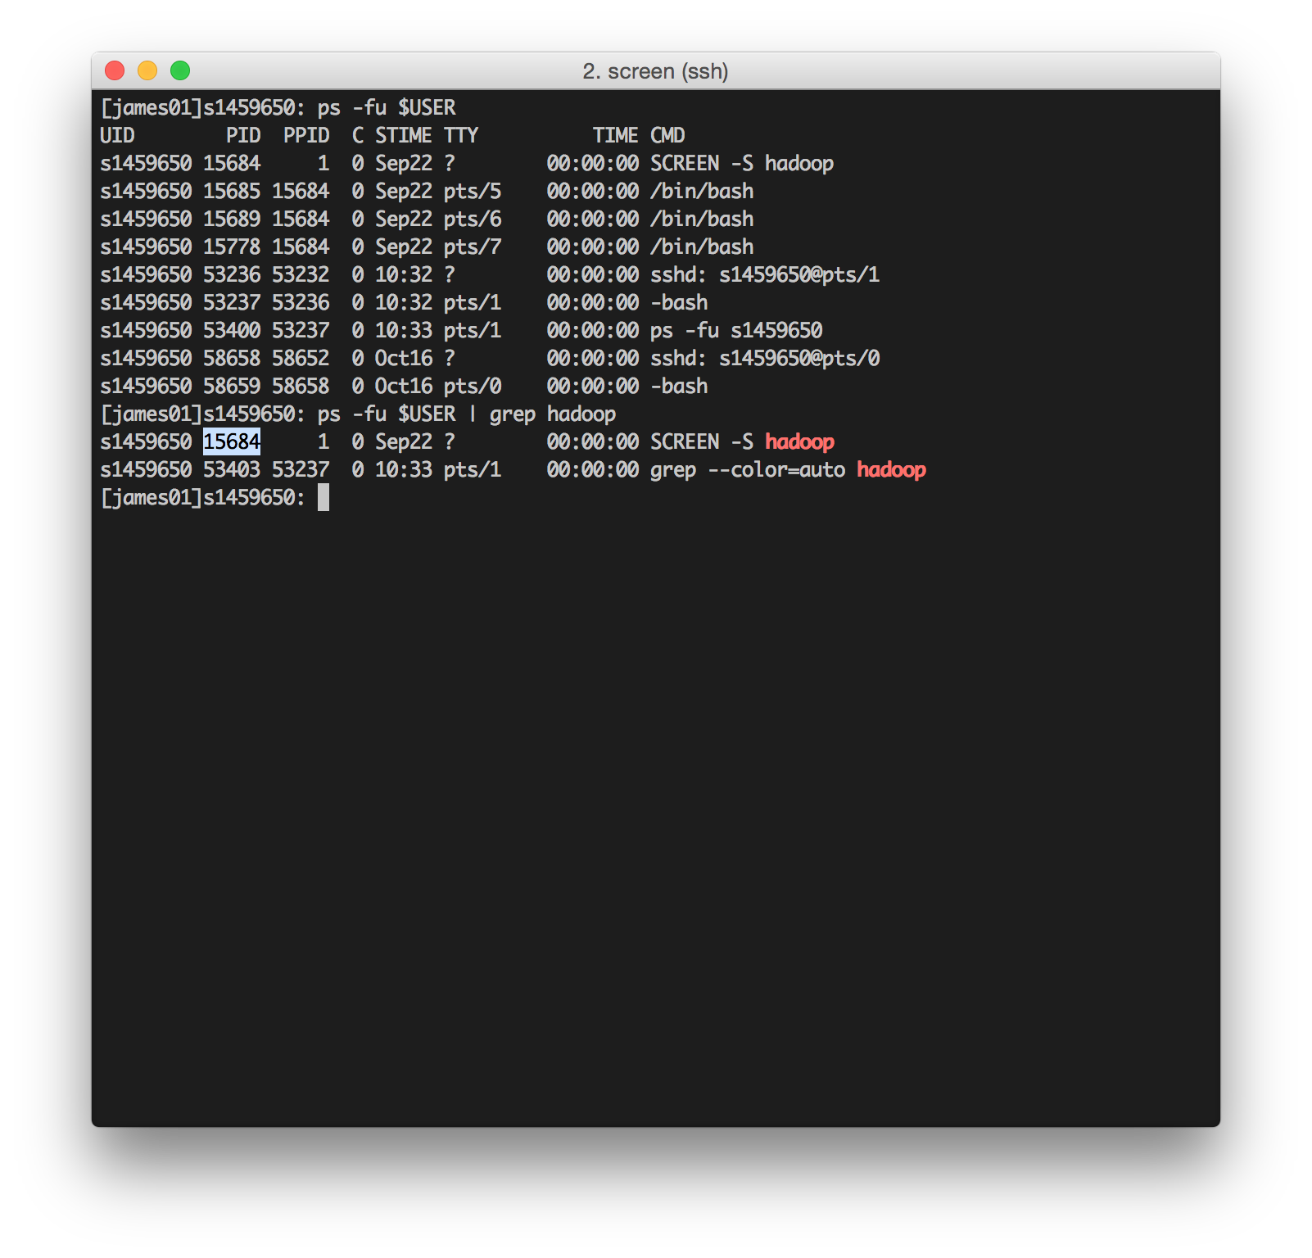
UNIX 101: killing jobs
ps -fu $USER
UNIX pipe
grep $pattern
get PID
kill $PID
If it just won’t die…
kill -9 $PID

Slide 19
Problem: the software I want isn’t there
Python:
use pip install --user $package
Source:
Compile in userspace
Make a designated binary folder (makes things easier) like ~/bin
Make a designated lib/src folder like ~/.apps
Move source to ~/.apps/$app_name
make
ln -s ~/.apps/$app_name/path/to/binary ~/bin/app_name
Preprend ~/bin to $PATH in .bash_profile:
export $PATH=/afs/…/sXXXXXXX/bin:$PATH

Slide 20
Coming soon(ish? (maybe?))

Slide 21
Real cluster
We should get Sun/Oracle Grid Engine (or some derivative thereof)
Happy to do another thing then with more info
Remember: the cluster as it is == the wild west
Protect your data

Slide 22
External Access
From anywhere that isn’t the forum

Slide 23
DICE vs. AFS
DICE
AFS
The collection of software available
Configured (only) by IS
The hardware available
Desktops
Servers
etc.
Andrew File System
Used by many organisations
Distributed FS
Adds /afs space to local FS
Local cache
UNIX permissions

Slide 24
DICE
Distributed Informatics Computing Environment

Slide 25

“Scientific Linux”

Slide 26
External access
ssh sXXXXXXX@student.ssh.inf.ed.ac.uk
ssh sXXXXXXX@staff.ssh.inf.ed.ac.uk
Only two public-facing endpoints
‘gatekeepers’
Do not permit work to be done (try running submit)
Need to move onto somewhere else:
General: ssh student.compute
CDT: ssh $CDT_node

Slide 27
Remote graphical: NX Config
Two endpoints:
nx.inf.ed.ac.uk -- everyone
staff.nx.inf.ed.ac.uk -- staff & research students
Memory cap: 1GB
Shared resources
Should still use ssh etc. for big work
Good client: https://www.nomachine.com/
More info: http://computing.help.inf.ed.ac.uk/nx
Note: I’ve never got this to work, may just be down.

Slide 28
Accessing your workstation
Unless you’re self managed, not possible.
DICE:
Can and will update your system & reboot without your consent
IP is dynamic
Self-managed:
Can request a static IP
Can configure sshd etc.
Can configure VNC (if that’s your kinda thing)
Trying to host services to pipe through gateway and home will be problematic.
IS clearly want to limit data input/output on random ports.

Slide 29
X-Forwarding
This can be fun (if you’re lame like me)
You can get X (the Linux window manager) to use your local display as its display
Example: you need to check something in a (new) MATLAB session running physically on your workstation, but you’re at your laptop:
ssh -Y sXXXXXXX@student.ssh.inf.ed.ac.uk
ssh -Y me@mycomputer
matlab
Mac & Windows users -- Install X11 to make this work

Slide 30
Virtual DICE
Can be used with VirtualBox
Great for self-managed people
Needs about 40GB space
More info: http://computing.help.inf.ed.ac.uk/vdice-install

Slide 31
AFS
ACCESSING YOUR HOME DIRECTORy

Slide 32
Kerberos
This is a widely used, ticket-based authentication system
Available for all major platforms
Same process, get ticket -- goes into your filesystem
Can reconnect upon network going down
Crucial: has a cache!
Still need to get a new ticket every 18(?) hours
More info: http://computing.help.inf.ed.ac.uk/informatics-filesystem

Slide 33
sshfs
Extension to ssh that permits the mounting of remote filesystems on a local machine.
Far less intrusive.
UNIXes only(?)
Make a local target directory where your remote directory will be mounted
sshfs sXXXXXXX@student.ssh.inf.ed.ac.uk:/path/to/folder local_folder
Do work using local apps but, crucially, on remote files
fusermount -u local_folder

Slide 34

Samba
This is Windows
I don’t know how to Windows
Maybe someone else knows
If you do, feel free to update this slide.
Probably something to do with PuTTY.
Sorry.
User cmder -- https://github.com/cmderdev/cmder

Slide 35
Conclusion
Stability: Kerberos > sshfs
Simplicity: sshfs > Kerberos
The caching point is key
Kerberos gives you the AFS on your machine
Have to be careful on full-system searches (slow)

Slide 36
VPN
virtual private networking

Slide 37
Why VPN?
As you’ve noticed, a bunch of stuff only works if the server you’re accessing thinks you’re in the forum:
Wiki(?)
Teaching pages
Intranet
VPN allows you to emulate this by doing black magic with your network configuration.
Also masks your network traffic as a whole.
Great strategy when using WiFi in public / untrusted places.
Also good to stream Netflix when you’re abroad.
Easy to configure: http://computing.help.inf.ed.ac.uk/openvpn

Slide 38

Thanks

